Slide 1
Low-Level Software Vulnerabilities Dr Federica Paci
COMP6236 - Software Engineering and Cyber Security

Slide 2
Today
Quiz on program memory layout (10 min)
Software Vulnerabilities Taxonomy
Buffer Overflows
Stack Overflows
Heap Overflows
Integer Overflows
Format String Overflows

Slide 3
Learning outcomes
By the end of this session you will be able to
Define what a buffer overflow is
List all the possible types of buffer overflow vulnerabilities

Slide 4
A Vulnerability Taxonomy
Input Validation and Representation
Buffer Overflow
API Abuse
Security Features
Time and State
Error Handling
Code Quality
Encapsulation
Seven Pernicious Kingdoms:
A Taxonomy of Software Security Errors

Slide 5
Other Taxonomies
OWASP Top 10 (last 2013)
19 Deadly Sins of Software Security by Howard, LeBlanc, and Viega (2005)
A Software Flaw Taxonomy: Aiming Tools at Security by Weber, Karger, Paradkar (2005)

Slide 6

What is buffer overflow?
A buffer overflow is a bug that affects low-level code, typically in C and C++, with significant security implications
Normally, a program with this bug will simply crash
But an attacker can alter the situations that cause the program to do much worse
Steal private information
Corrupt valuable information
Run code of the attacker’s choice

Slide 7
Why study them?
Buffer overflows are still relevant today
C and C++ are still popular
Buffer overflows still occur with regularly
They have a long history
Many different approaches developed to defend against them, and bugs like them
They share common features with other bugs that we will study
In how the attack works
In how to defend against it

Slide 8
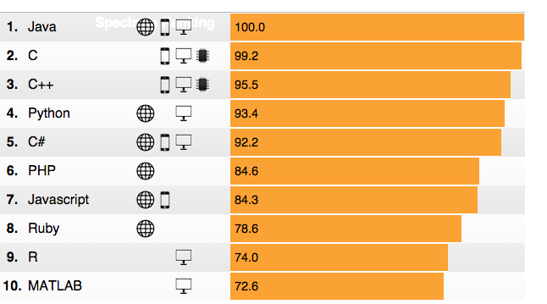
C and C++ still very popular

Slide 9
Critical systems in C/C++
Most OS kernels and utilities
fingerd, X windows server, shell
Many high-performance servers
Microsoft IIS, Apache httpd, nginx
Microsoft SQL server, MySQL, redis
Many embedded systems
Mars rover, industrial control systems, automobiles

Slide 10
History of buffer overflows
Morris worm (1988)
Propagated across machines
One way it propagated was a buffer overflow attack against a vulnerable version of fingerd on VAXes
Sent a special string to the finger daemon, which caused it to execute code that created a new worm copy
Didn’t check OS: caused Suns running BSD to crash
End result: $10-100 in damages, probation and community service
Morris is now a professor at MIT

Slide 11
History of buffer overflow
Code Red (2001)
Exploited an overflow in the MS-ISS server
300,00o machines infected in 14 hours
SQL Slammer (2003)
Exploited an overflow in the MS-SQL server
75,000 machines infected in 10 minutes
Notes:
Add some more details

Slide 12
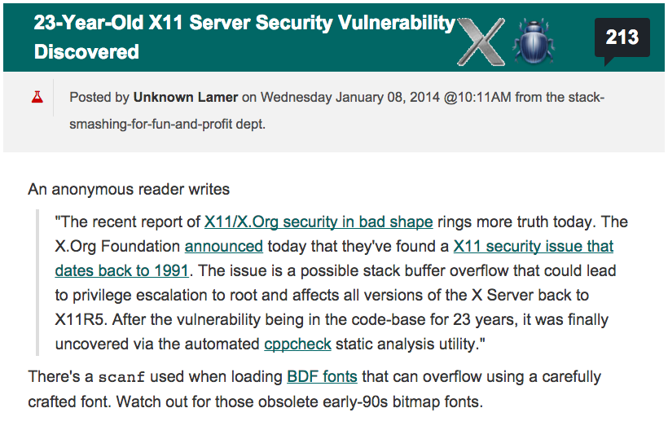
History of buffer overflow

Slide 13
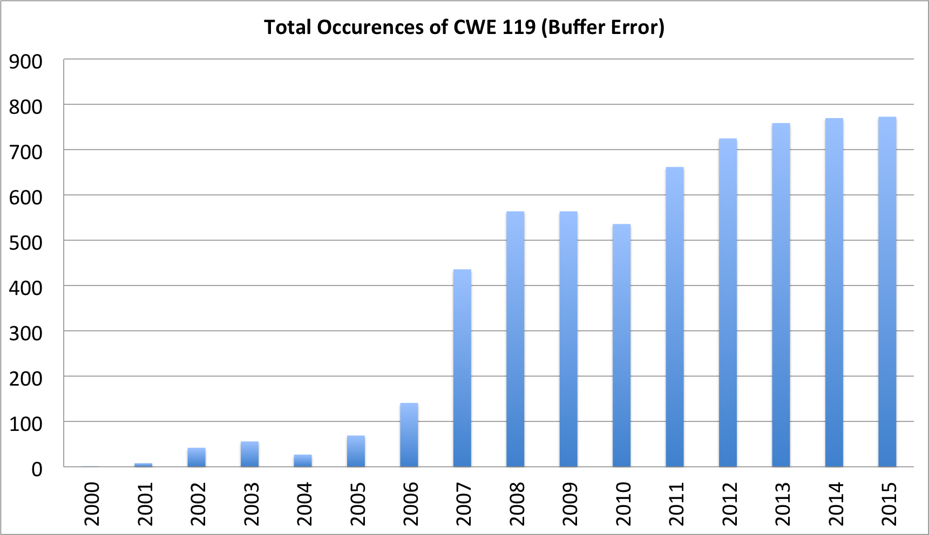
Trends

Slide 14
Buffer overflows in a nutshell
Buffer =
Contiguous memory associated with a variable or field
Common in C
All strings are (NUL-terminated) array of char’s
Overflow =
Put more into the buffer that it can hold
Where does the overflowing data go?

Slide 15
Buffer overflow
void func (char *arg1)
{
char buffer[4];
strcpy(buffer, arg1);
}
int main ()
{
char *mystr = “AuthMe!”;
func(mystr);
}
M e ! \0
00 00 00 00
A u t h
4d 65 21 00
%ebp
%eip
&arg1
buffer

Slide 16
Buffer overflow
void func (char *arg1)
{
int authenticated = 0
char buffer[4];
strcpy(buffer, arg1);
if (authenticated){…
}
}
int main ()
{
char *mystr = “AuthMe!”;
func(mystr);
}
M e ! \0
00 00 00 00
A u t h
4d 65 21 00
00 00 00 00
%ebp
%eip
&arg1
buffer
authenticated

Slide 17
Could it be worst?
void func (char *arg1)
{
char buffer[4];
strcpy(buffer, arg1);
}
int main ()
{
char *mystr = “AuthMe!”;
func(mystr);
}
Code!
00 00 00 00
%ebp
%eip
&arg1
buffer

Slide 18
Code Injection
void func (char *arg1)
{
char buffer[4];
strcpy(buffer, arg1);
}
%eip
%eip
Text ...
00 00 00 00
%ebp
%eip
&arg1
Code
buffer
Load attacker’s code into memory
(2) Somehow get %eip to point to it

Slide 19
Step 1 - Create the injection vector
Address of
Shellcode
NOP sled
Shellcode
Shellcode address:
the address of the memory region that contains the shellcode
Shellcode:
a sequence of machine instructions to be executed (e.g. execve("/bin/sh"))
NOP sled:
a sequence of do-nothing instructions (nop). It is used to ease the exploitation: attacker can jump anywhere inside, and will eventually reach the shellcode (optional)

Slide 20
Step 1 – What code to run?
It must be the machine code instructions (i.e., already compiled and ready to run
We have to be careful in how we construct it
It can’t contain any all-zero bytes
Otherwise, sprintf, gets,scanf/ will stop copying
How could you write assembly to never contain a full zero byte?
It can’t use the loader (we’re injecting)

Slide 21
Step 1- What code to run?
#include <stdio.h>
int main ()
{
char *name[2];
name[0] = “/bin/sh”;
name[1] = NULL;
execve(name[0], name, NULL);
}
Source Code
xor %eax,%eax
push1 %eax
push1 $0x68732f2f
push1 $0x6e69622f
mov1 %esp, %ebx
push1 %eax
...
“\x31\xc0”
“\x50”
“\x68””//sh”
“\x68””/ bin”
“\x89\xe3”
“\x50”
Assembly
Machine Code
Input

Slide 22
Step 1 -How do we create the vector?
Create the shellcode
Prepend the NOP sleds
“x90”
Add the address
0xbfffeeb0
Address of
Shellcode
NOP sled
Shellcode

Slide 23
Step 2 - Getting injected code to run
We load the injection vector as an argument of the vulnerable function
When strcpy is executed, we overflow the buffer with the injection vector
The value of %eip is overwritten with the address of shellcode
Address
of Shellcode
Injection
Vector
00 00 00 00 00 00 00
%ebp
00 00 00 00 00 00 00
NOP sled
Shellcode
%eip
buffer

Slide 24
Other Attacks
The code injection attack we have just considered is called stack smashing
The term was coined by Aleph One in 1996
Stack smashing overflows a stack allocated buffer
You can also overflow a buffer allocated by malloc, which resides on the heap

Slide 25
Heap Overflow
typedef struct _vulnerable_struct {
char buff[MAX_LEN];
int (*cmp)(char*, char*);
} vulnerable;
int foo (vulnerable* s, char* one, char* two)
{
strcpy(s->buff, one);
strcpy(s->buff, two);
return s->cmp(s->buff, “file://foobar”);
}
Must have strlen(one)+strlen(two) < MAX_LEN
or we overwrite s->cmp

Slide 26
Integer overflow
void vulnerable() {
char* response;
int nresp = packet_get_int();
if (nresp > 0) {
response = malloc(nresp*sizeof(char*));
for (i=0; i < nresp; i++) {
response[i] = packet_get_string(char*);
}
}
}
If we set nresp to 1073741824 and sizeof(char*) is 4
Then nresp*sizeof(char*) overflows to become 0
Subsequent writes to allocated response, overflow it

Slide 27
Read Overflow
int main() {
char buf[100], *p;
int i, len;
while (1) {
p = fgets(buf, sizeof(buf), stdin);
if (p == NULL) return 0;
len = atoi(p);
p = fgets(buf, sizeof(buf), stdin);
if (p == NULL) return 0;
for (i = 0; i < len; i++)
if (!iscntrl(buf[i])) putchar(buf[i]);
else putchar(‘.’);
printf(“\n”);
}}
Read integer
Read message
Echo back
(partial)
message
May exceed actual
message length

Slide 28
Sample transcript
bash$ ./echo-server
24
every good boy does fine
ECHO: |every good boy does fine|
10
hello there
ECHO: |hello ther|
25
hello
ECHO: |hello..here..y does fine|
OK: input length < buffer size
BAD: length > buffer size
leaked data

Slide 29
Heartbleed
The Heartbleed was a read overflow in exactly this style
The SSL server should accept a “heartbeat” message that it echoes back
The heartbeat message specifies the length of its echo-back portion, but the buggy SSL software did not check the length was accurate
Thus an attacker could request a longer length, and read past the contents of the buffer
Leaking passwords, crypto keys, etc…

Slide 30
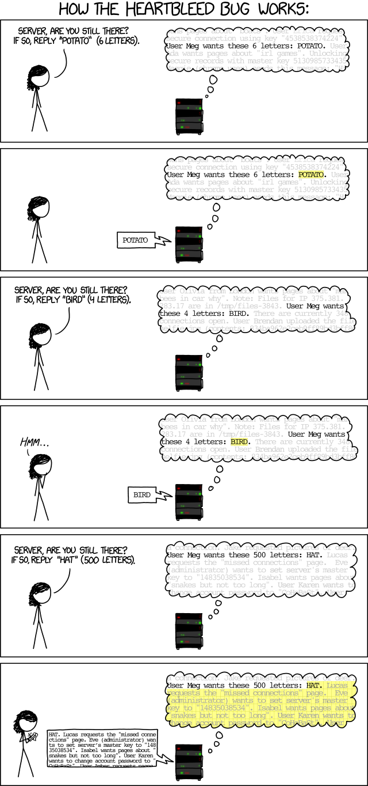
Heartbleed explained
Image from xkcd.com

Slide 31
Formatted I/O
C’s printf family supports formatted I/O
Format specifiers
Position in string indicates stack argument to print
Kind of specifier indicates type of the argument
%s = string, %d= integer etc.
void print_record(int age, char *name)
{
printf(“Name: %s\tAge: %d\n”, name, age);
}

Slide 32
What’s the difference?
void safe()
{
char buf[80];
If(fgets(buf, sizeof(buf), stdin) == NULL)
return;
printf(“%s”, buf );
}
void vulnerable()
{
char buf[80];
if(fgets(buf, sizeof(buf), stdin) == NULL)
return;
printf(buf);
}

Slide 33
printf implementation
printf takes variable number of arguments
printf pays no mind to where the stack frame ends
It presumes it is called with as a many arguments as specified in the format string
int i=10;
printf(“%d %p\n”, i, &i);
0x00000000
0xffffffff
...
%ebp
%eip
&fmt
10
&i
printf’s stack frame
caller’s stack frame

Slide 34
void vulnerable()
{
char buf[80];
if(fgets(buf, sizeof(buf), stdin) == NULL)
return;
printf(buf);
}
”%d %x”
0x00000000
0xffffffff
...
%ebp
%eip
&fmt
printf’s stack frame
caller’s stack frame

Slide 35
Why is this a buffer overflow?
We should think of this as a buffer overflow in the sense that
The stack itself can be viewed as a kind of buffer
The size of that buffer is determined by the number and size of the arguments passed to the function
Providing a bogus format string thus induces the program to overflow that “buffer”

Slide 36
Summary
Buffer overflow is an astonishingly simple bug
A buffer overflow happens when more data is written to or read from a buffer than the buffer can hold
Various types of attacks
Stack Overflows
Heap Overflows
Integer Overflows
Format String Overflows

Slide 37
For Thursday’s lecture
Bring your laptop
Install VirtualBox
Download virtual machine and instructions from
https://www.dropbox.com/sh/g2ivr1ixj565y8l/AAB7QS9D40OpsX2I5rYgT1R7a?dl=0

Slide 38
Reading Material
Taxonomy
G. McGraw. Software Security, Building Security In. Chapter 12
Buffer Overflow
Viega, McGraw. Building Secure Software. Chapter 7.
Code Red
https://technet.microsoft.com/library/security/ms01-033

